Slide 1
DNA Starter
What is poverty?
Name a charity that helps people in poverty __________
What is Genocide?
What was the Holocaust?
What was the main religion of people persecuted during the Holocaust? _________
DNA Starter
What is poverty?
Name a charity that helps people in poverty __________
What is Genocide?
What was the Holocaust?
What was the main religion of people persecuted during the Holocaust? __________
Notes:
Print… give when they walk in

Slide 2
Let me tell you about Rwanda!
To be able to identify where Rwanda is located on a map.
To be able to describe what life is like for someone who lives in Rwanda.
To be able to evaluate how different our life is in the UK compared to someone who lives in Rwanda.

Slide 3
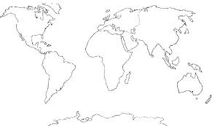
Where is Rwanda located?

Slide 4
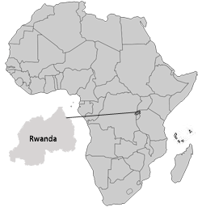
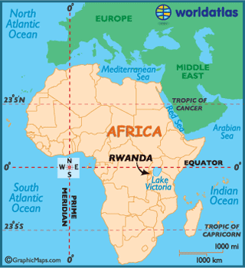
Where is Rwanda located?
Rwanda is located in Africa!
Notes:
Could do a mini description task – explain where Rwanda is, north south east west, whats close etc.

Slide 5
Task: What is life like?
You are now going to be finding out facts about what it is lie to live in Rwanda.
Your task is to use the information, and summarise it to the most important facts.
You can present this information in a table, or any format of your choice. Below is an example…
Extension: Would you be able to live in Rwanda? Why?
Location/Facts
Transport
Food
Tourism
Animals
Education
General life
Challenge: What do you think would be the most challenging thing about living in Rwanda?
What would be the easiest thing to adjust to?

Slide 6
Task: Comparing lives…
Meet Sifa.
This is Sifa explaining what a general day is like for her and her family.
Whilst you are watching this you need
to think of the following…..
4 Ways your life is similar to Sifa’s
4 Ways your life is different to Sifa’s.
https://www.youtube.com/watch?v=0-EOnaliBBs
Extension: Does Sifa live in Poverty? How can you tell this?
Challenge: How could Sifa’s life be improved?

Slide 7

Extention Task: Comparing lives…
Create two small Dear Diary entries showing the differences of living in the UK and Rwanda.
How would your day to day lives be different?
Tips…
What would you eat for breakfast?
Would you both go to school? How would you get there?
Would you have a shower?
How would you get clean water?

Slide 8

Plenary: Text
Draw the outline of a phone in your book.
Inside it, write a text to a friend letting them know you are in Rwanda.
What can you…
Hear
Smell
See
Feel
Taste

